Slide 1
Dear XXXX,
As you know, I am always looking for professional development opportunities so that I can continue to strengthen my teaching and ensure my students reach their fullest potential. That has never been more important than now because I am helping many of my students catch up from learning loss.
At our school, there are (number of students) in (grade level). According to the most recent test data, (percentage)% of students are below grade level in reading. That is why I am writing to request funding for a 4-week teacher training called The Reading Roadmap. It is revolutionizing the way pre-k, kindergarten, and first grade teachers assess, plan, teach, and grow as professionals. This is how…
Recent national data shows 65% of 4th graders in the United States read below grade level. While this number is sobering, research also tells us that when teachers use science of reading aligned practices and resources, 95% of students CAN learn to read by the end of first grade.
Mississippi is an amazing example of this effect! After training their teachers in science of reading-based strategies and tools, Mississippi moved from being the bottom performing state on the National Assessment of Educational Progress to becoming number one in student growth. I am excited to experience that same success in my classroom! The Reading Roadmap gives teachers like me the key to unlocking students’ reading progress by providing both the knowledge and tools we need to effectively start implementing research-based best practices.
The Reading Roadmap training includes:
Lifetime access to on-demand video trainings that break down key science of reading strategies so that I can confidently build students’ phonemic awareness, phonics, orthographic mapping, reading fluency, and comprehension
A simple four-step system for assessing, planning, and teaching that makes it easy to meet each student’s needs and strengths
A year’s-worth of daily phonemic awareness warm-ups to build students’ reading foundation
One year of daily phonics warm ups to solidify readers’ letter-sound connections
Powerful assessments that uncover what students are really struggling with and then provide research-based next steps for fast progress
Decodable passages grouped by phonics skill to help develop students’ decoding, fluency, and comprehension skills
A data tracker that organizes student growth and monitors skill gaps
Hundreds of ready-to-use and playful decodable centers that make learning to read fun for children
Interviews with literacy experts outlining latest research and teaching tools
A community of teachers who collaborate, brainstorm, and problem solve together so that I have ongoing support

Slide 2
The science of reading-based resources and professional development tools in The Reading Roadmap will help me best meet my students’ diverse needs, and consequently, will significantly improve their reading growth. I know that funds are limited and I am prepared to devote the time necessary to use the high-quality resources and trainings available in the course and implement them in my classroom.
The one-time cost for lifetime access is $397. The Reading Roadmap offers a 20% discount for groups of 10 or more staff and I am sure colleagues would love the opportunity as well.
Enrollment opens twice a year and the next round is September 25 to October 6th.
I am hopeful that you will grant my request and am attaching additional materials that highlight the many benefits the training has to offer.
Appreciatively,
XXXXX

Slide 3
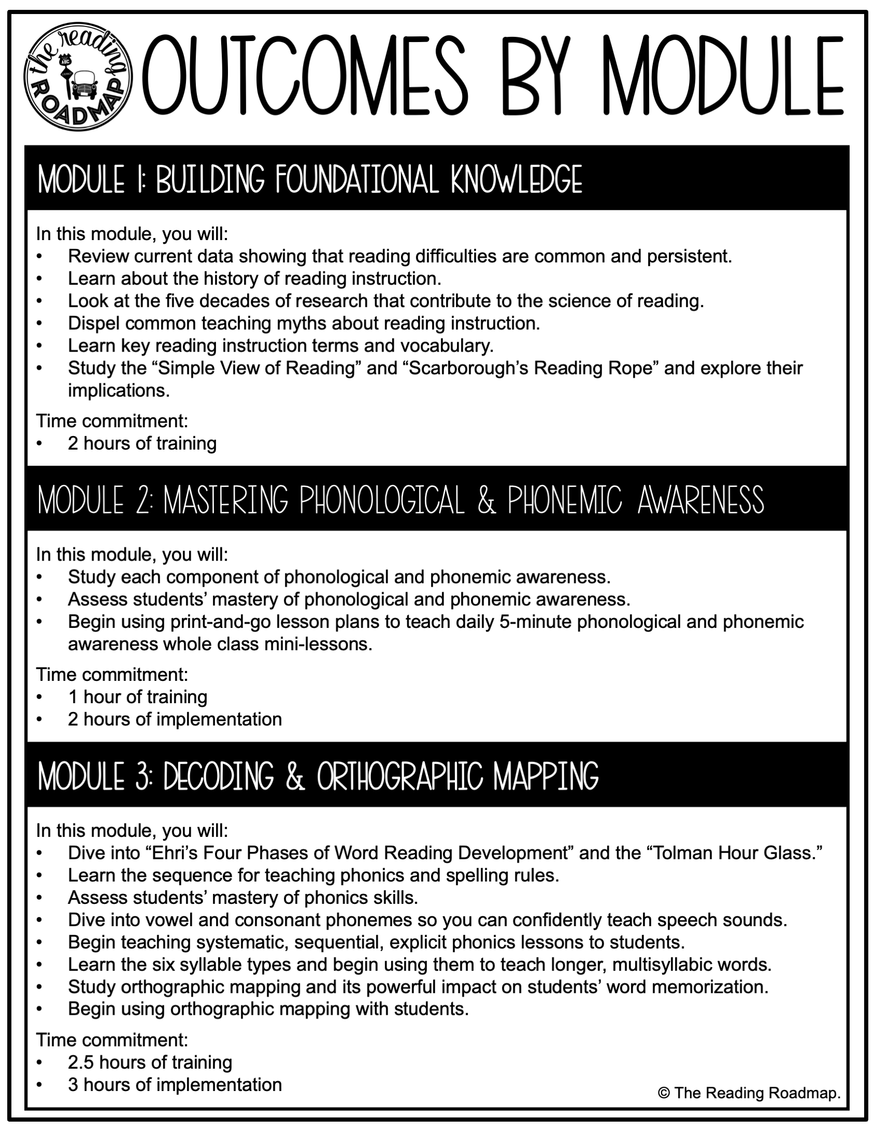

Slide 4
